Slide 1
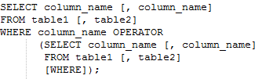
Nested Queries in SQL
Nested query or a sub-query is a query within another SQL query, embedded within the WHERE clause.
The sub-query executes first so that the data returned by the sub-query is used by the main SQL query as a condition to further restrict the data to be retrieved.
Nested queries must be enclosed within parentheses.
The basic syntax for using a sub-query with SELECT is:
Here the OPERATOR can be =, <, >, >=, <=, IN etc.

Slide 2



IN:
The IN operator allows you to specify multiple values in the WHERE clause of an SQL statement.
IN operator allows us to test whether a value is in a given set of elements.
IN is one of the most common operators used in sub-queries.
The basic syntax of IN operator is:
For example, in our STUDENTS table, let us find the details of all the students whose gpa values are 3.2, 3.5 and 3.8.
QUERY RESULT

Slide 3


Coming back to Nested queries, let us consider STUDENTS and COURSES table to retrieve the details of all students who received an ‘A’ grade.
This is can be achieved using the IN operator as shown below:
QUERY RESULT
The nested query computes the set of Sids for STUDENTS who received an A grade (the set contains 53666 and 53650), and the main SQL query retrieves the details of the STUDENTS whose Sid is in this set.
Note that it is easy to modify the above query to find the details of all the students who did not receive an A grade.
This can be achieved using the NOT IN operator as shown below:

Slide 4

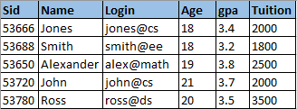
QUERY RESULT
‘Jones’ and ‘Alexander’ appear in both the results since they have secured both A and non-A grades in their courses.
Nested queries can also be used with INSERT, UPDATE and DELETE statements.
Suppose we want to increase the tuition fee by $500 for all the students who have taken courses with 4 credits.
This can be achieved with the UPDATE statement along with IN operator:

Slide 5

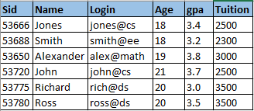

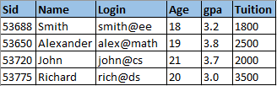
QUERY RESULT
As you can see in the above resultant table, the tuition of students with Sids 53666, 53720, 53688 and 53650 have been increased by $500.
Now suppose we want to delete the details of all students who have taken courses with credits less than 3. This can be achieved using:
QUERY RESULT

Slide 6

EXISTS:
The EXISTS operator is another comparison operator, such as IN, which checks the existence of a result of a sub-query.
The EXISTS tests whether a sub-query fetches at least one row. When no data is returned, this operator returns 'FALSE'.
When the sub-query fetches at least one row, this operator returns ‘TRUE’ and the outer query is executed to retrieve the results.
A valid EXISTS sub-query must contain a reference to the outer(main) query i.e., table used in the sub-query should have a join with the table used in the outer query.
The basic syntax for using EXISTS with SELECT is:

Slide 7


Consider our STUDENTS and COURSES tables. Now let us try to find the details of the students who have taken course C101.
We can retrieve the results using a EXISTS operator as shown below:
QUERY RESULT
Note that the sub-query has a reference to the main query via the join C.Stud_ID = S.Sid.
Since the sub-query results in at least one row of output, the EXISTS condition evaluates to TRUE and the results are retrieved as displayed above.

Slide 8

If you notice the EXISTS query, it works more or less like a IN operator. In fact, we can retrieve the same results using the IN operator as:
Then, what is the difference between IN and EXISTS? The basic difference lies in the way how these are executed.
IN: The inner query is executed first and the list of values obtained as the result, is used by the outer query. The inner query is executed only once.
EXISTS: The first row from the outer query is selected, then the inner query is executed and the outer query uses the result of inner query to evaluate to TRUE or FALSE. The sub-query is re-evaluated for each row of the outer query. That is, if there are ten rows that can result from outer query, the inner query is executed 10 times.

Slide 9

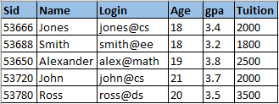
Basically both yield the same result but the difference lies in the way how IN and EXISTS operates.
Now, which to choose while writing the query? Some say EXISTS works faster than IN and some say IN is more efficient than EXISTS, but there's no clear answer.
Feel free to use whichever you are more comfortable with.
Now like NOT IN, we can use NOT EXISTS operator which works in a similar way as EXISTS, just to give the opposite result.
QUERY RESULT

Slide 10
Aggregate Functions
In addition to simply retrieving data, we often would want to perform some sort of computation or summarization.
SQL supports five powerful class of constructs to perform aggregate operations -
COUNT: The SQL COUNT function is used to count the number of rows/records in a database table.
MAX: The SQL MAX function is used to select the highest (maximum) value for a certain column in a database table.
MIN: The SQL MIN function is used to select the lowest (minimum) value for a certain column in a database table.
AVG: The SQL AVG function is used to select the average value for a certain column in a database table.

Slide 11



SUM: The SQL SUM function is used for computing the total for a numeric column in a database table.
Let us consider few examples to understand these aggregate operators in more detail.
Consider our STUDENTS table and suppose we want to know the total number of rows/records in this table. We can use COUNT operator as:
Suppose we want to know the total number of student records whose age 20 or more:

Slide 12







Suppose we want to know the number of unique values of tuition:
Suppose we want to know the highest tuition paid by a student:
Similarly if we want to know the highest gpa recorded:
We can combine MIN and MAX together as:

Slide 13





Suppose we want to know the average gpa of the class:
Suppose we want to know the total tuition paid by all the students:
Now suppose we want to know the name and age of the oldest student. We would try to achieve the result using the below query:
The intent of this query is to return not only the maximum age but also the name of the student having that age.

Slide 14


However, this query is illegal in SQL!
If the SELECT clause uses an aggregate operation, then it must use only aggregate operations unless the query contains a GROUP BY clause (The intuition behind this restriction should become clear when we discuss the GROUP BY clause in the next section).
Therefore, we cannot use MAX(S.Age) as well as S.Name in the SELECT clause. We have to use a nested query to compute the desired result:
QUERY RESULT
We will see more examples of using aggregate operators, especially with GROUP BY and HAVING clause in the next section.

